Slide 1
TABLEAU PROJECT(AFRICAN MOBILE DATA SALES ANALYSIS)
BY
JYOTHSNA MADAMANCHI

Slide 2
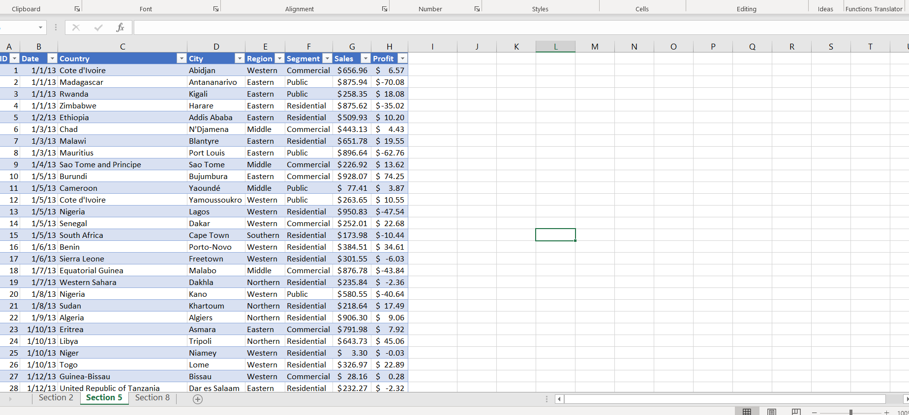

Slide 3
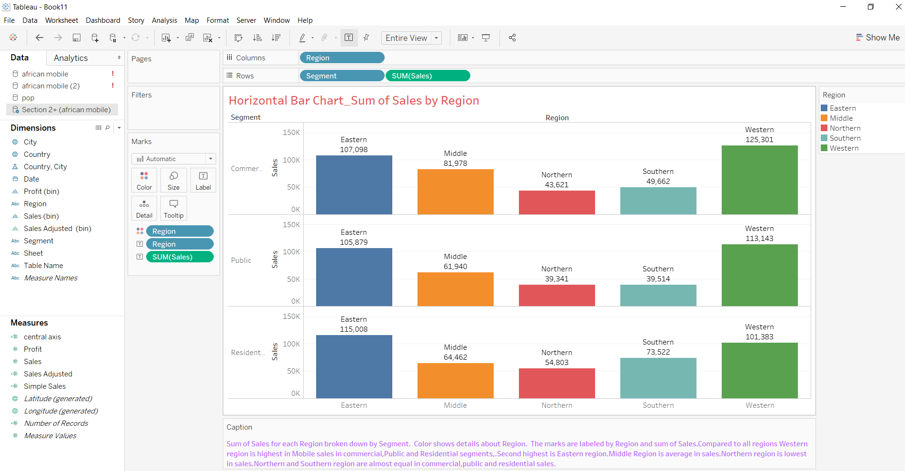

Slide 4
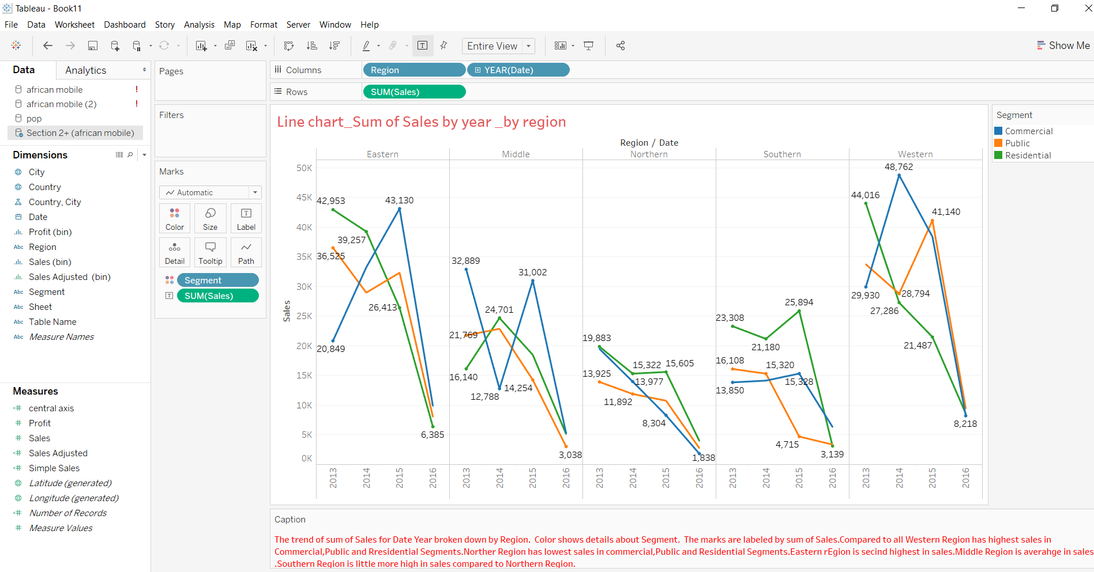

Slide 5
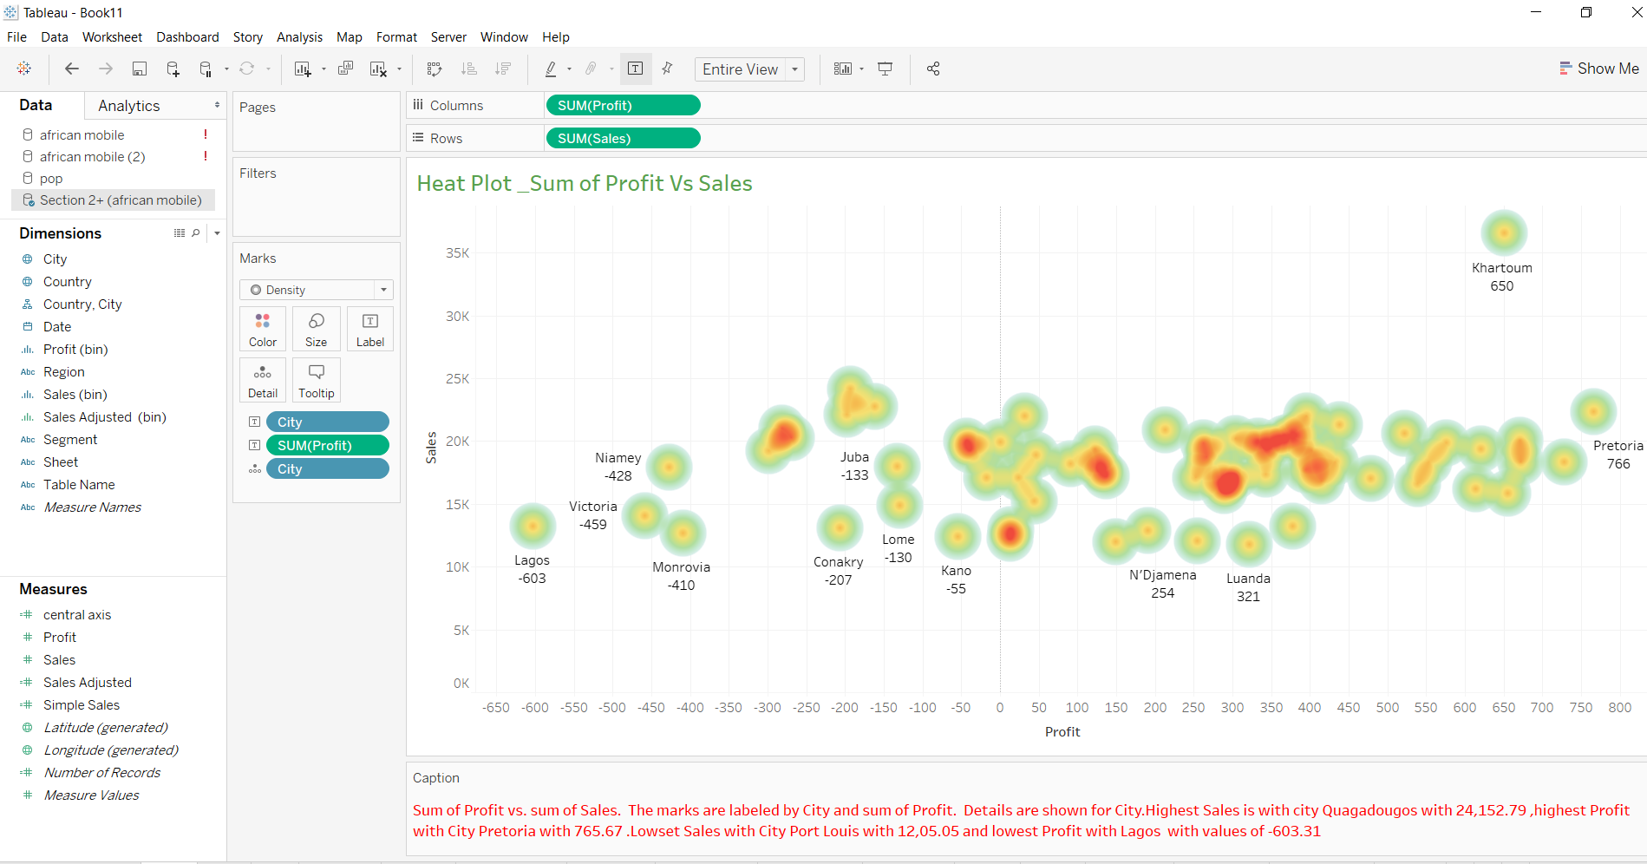

Slide 6
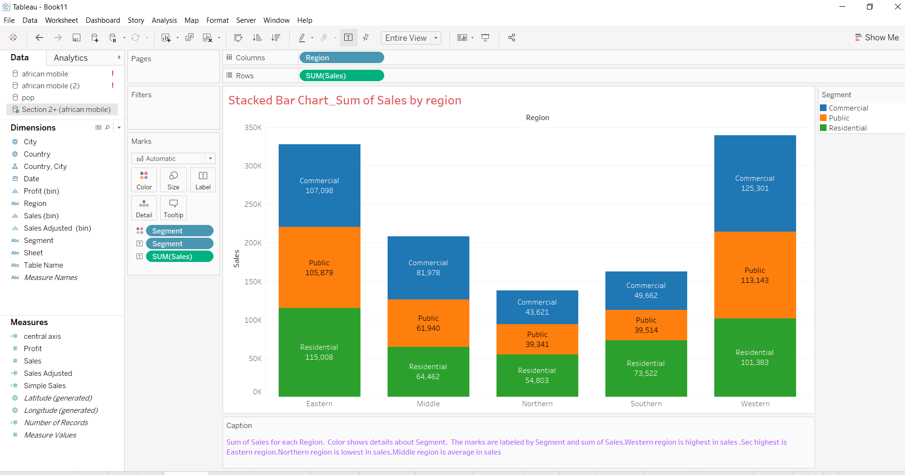

Slide 7
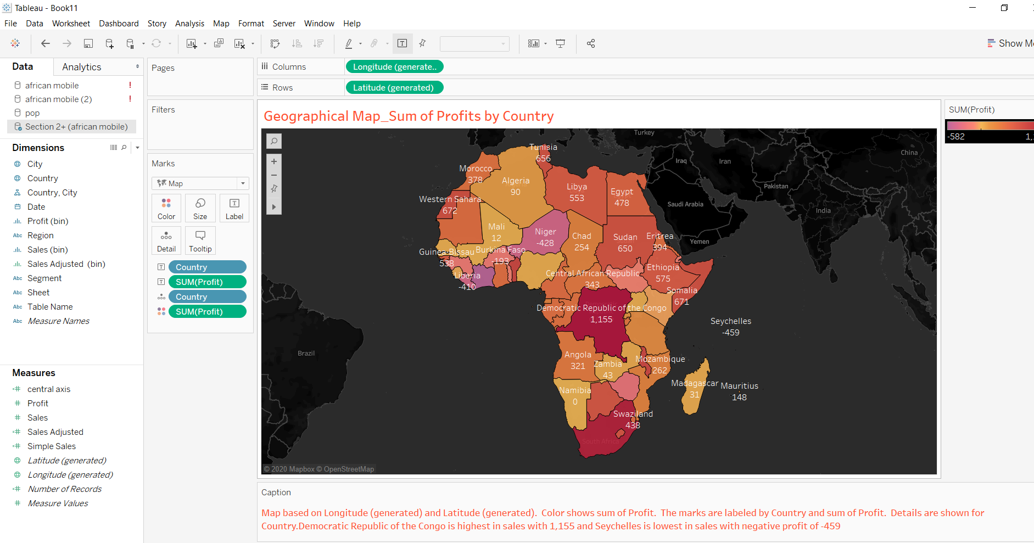

Slide 8
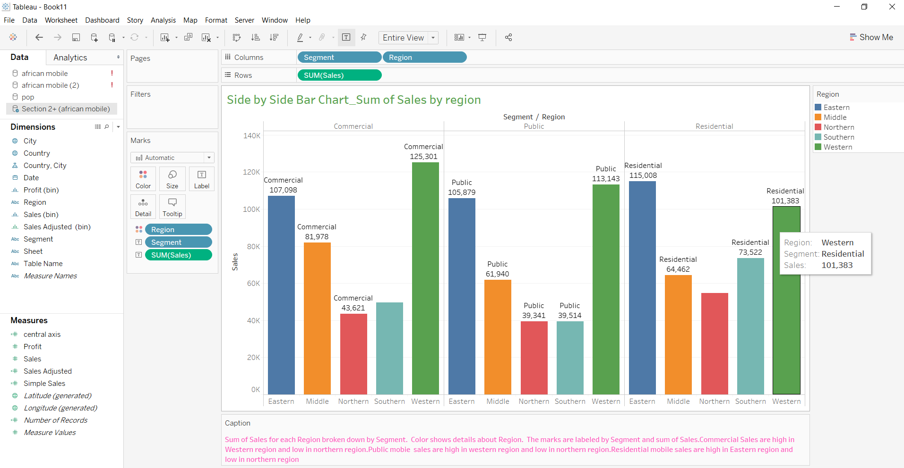

Slide 9
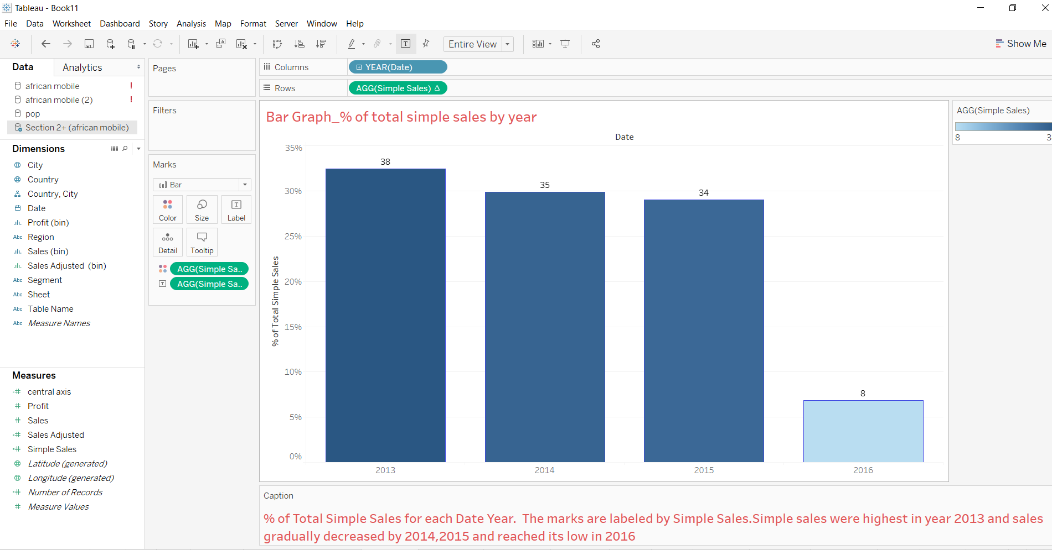

Slide 10
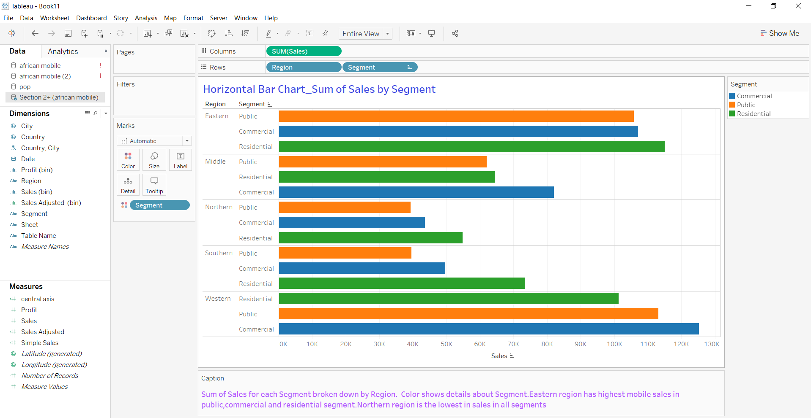

Slide 11
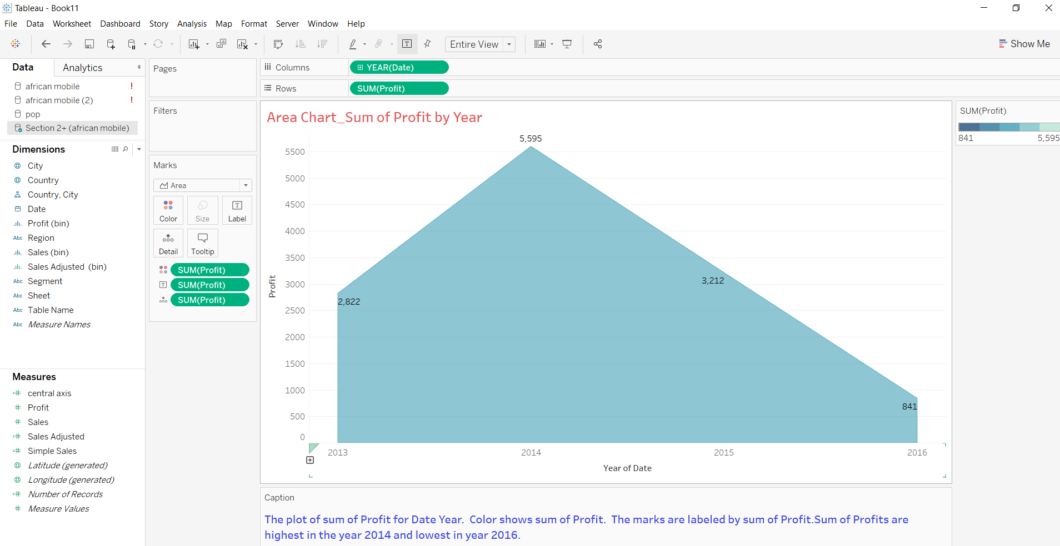

Slide 12
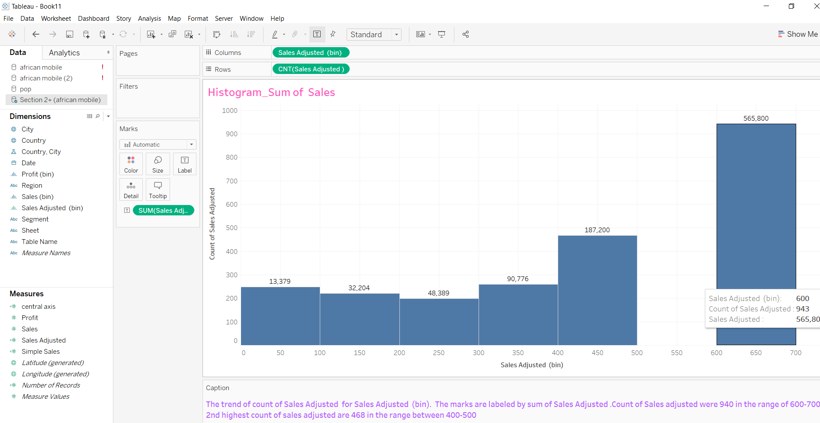

Slide 13
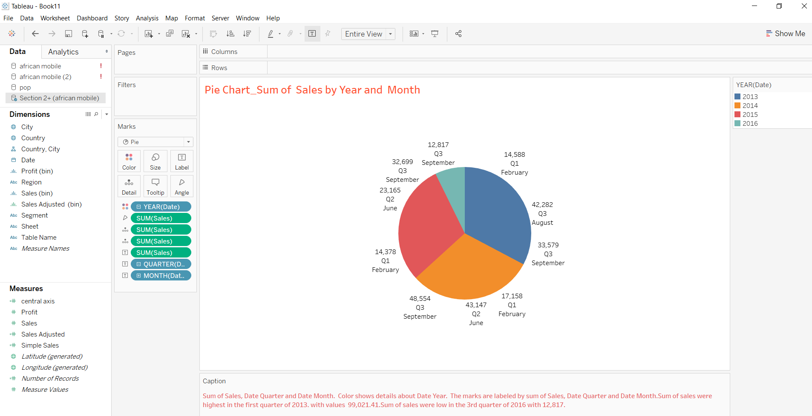

Slide 14
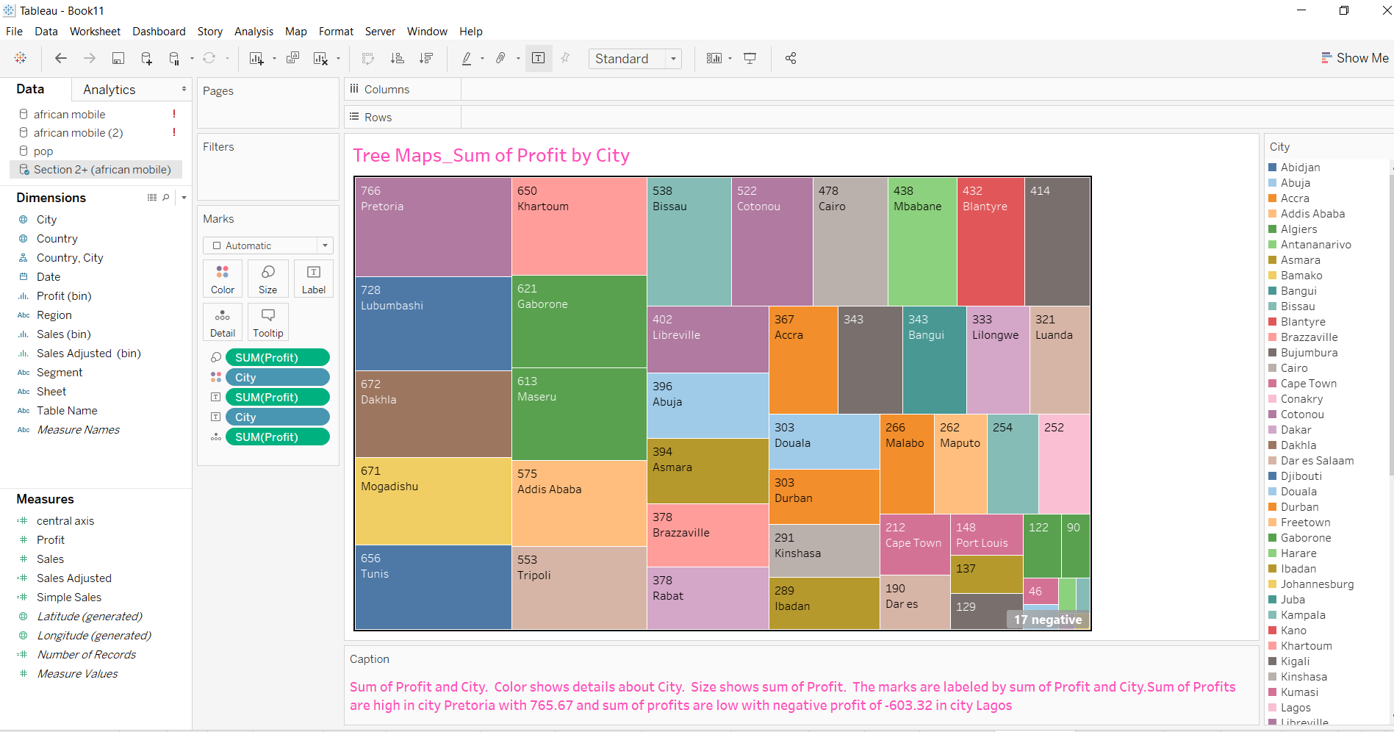

Slide 15
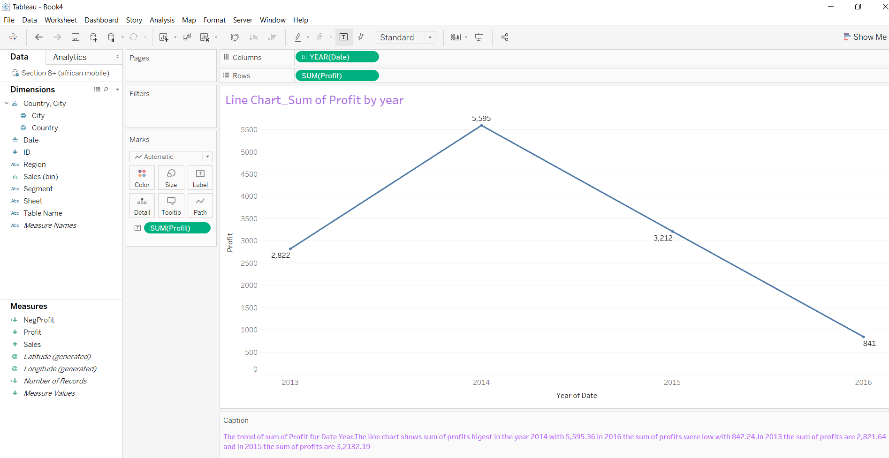

Slide 16
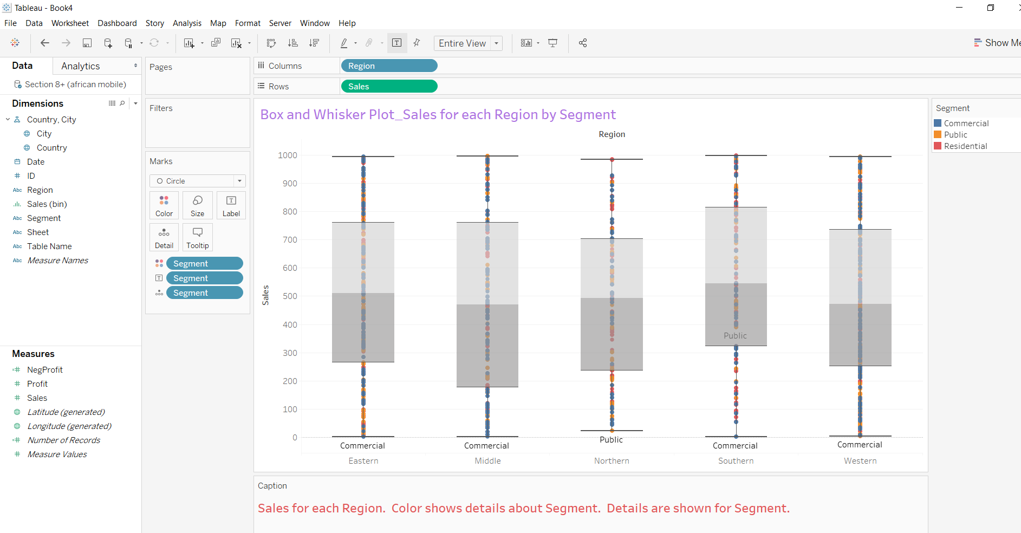

Slide 17
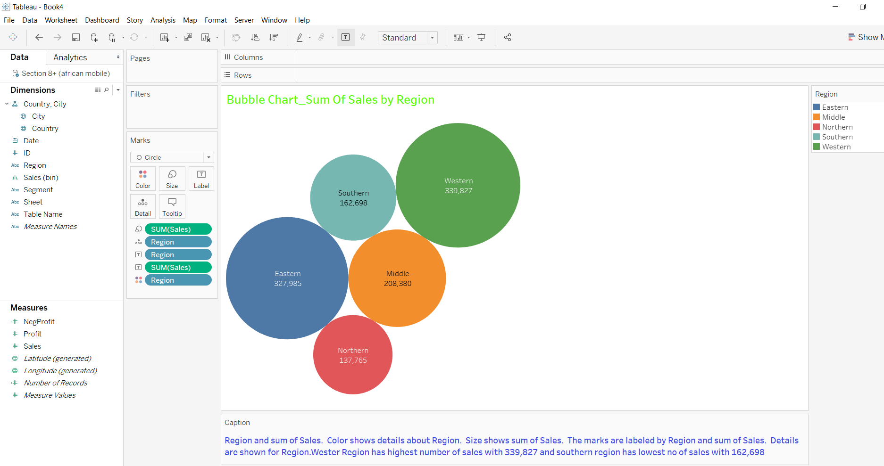

Slide 18
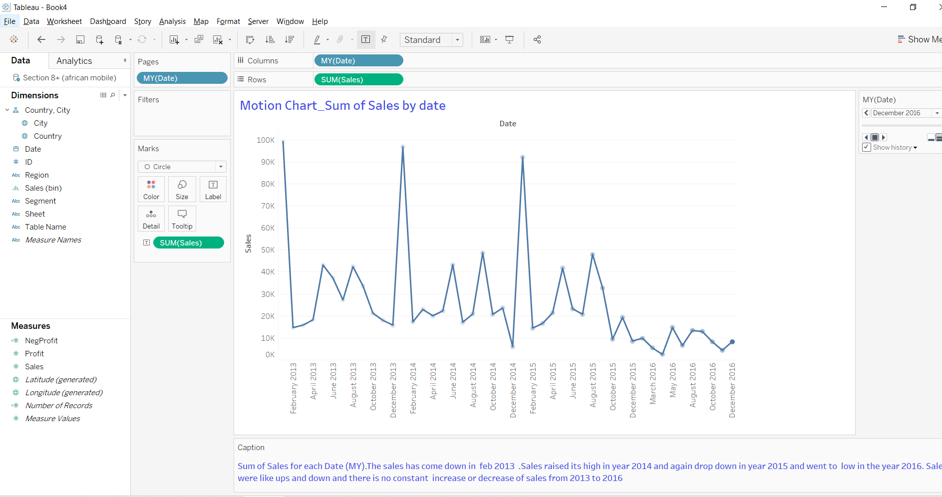

Slide 19
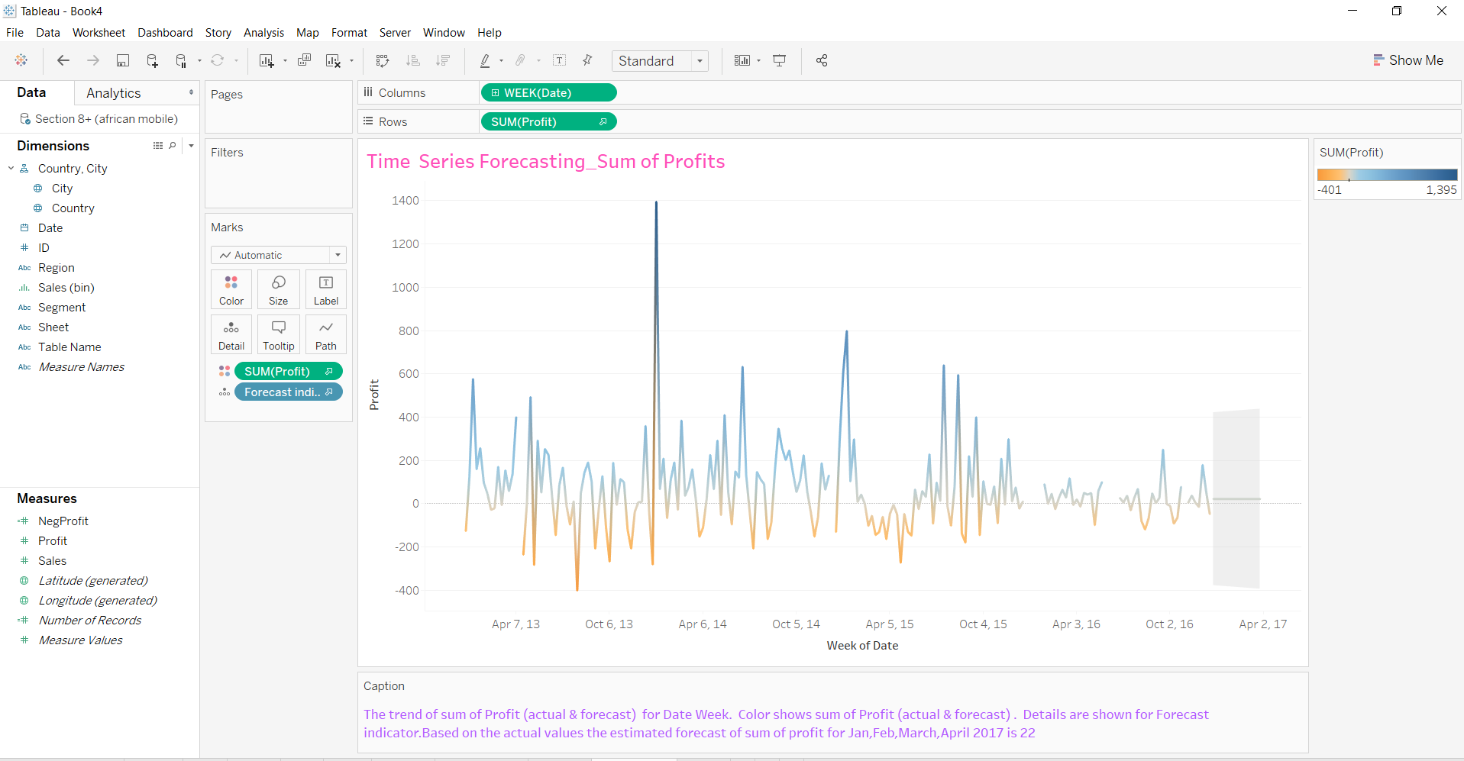

Slide 20
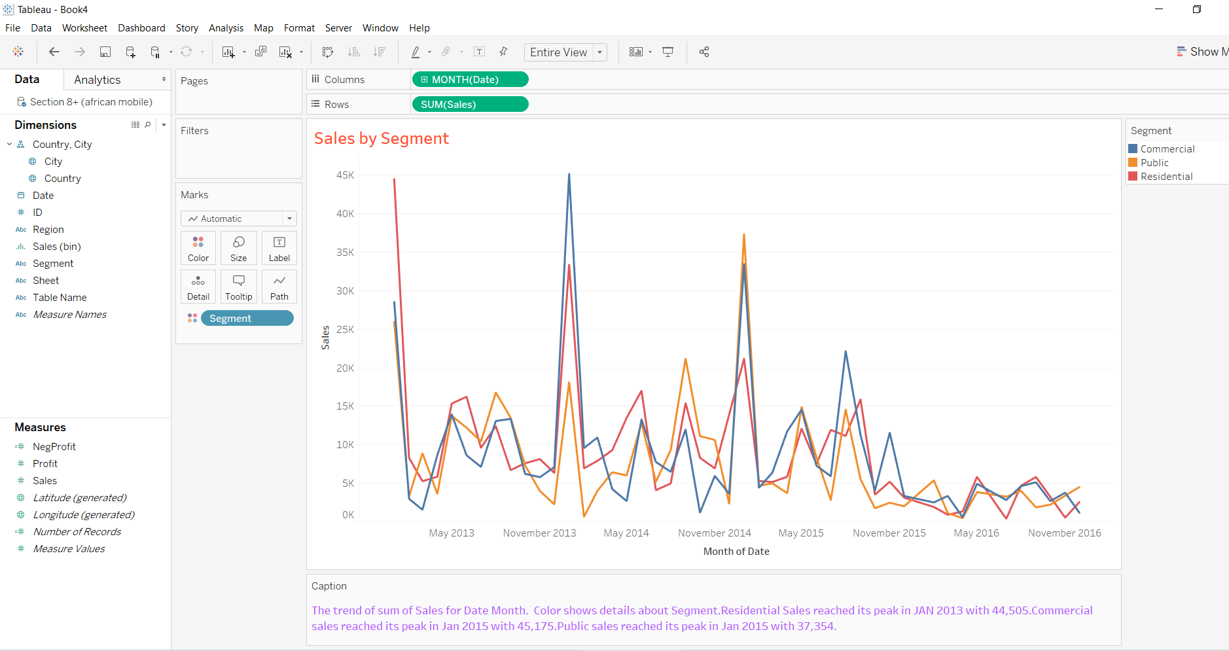

Slide 21
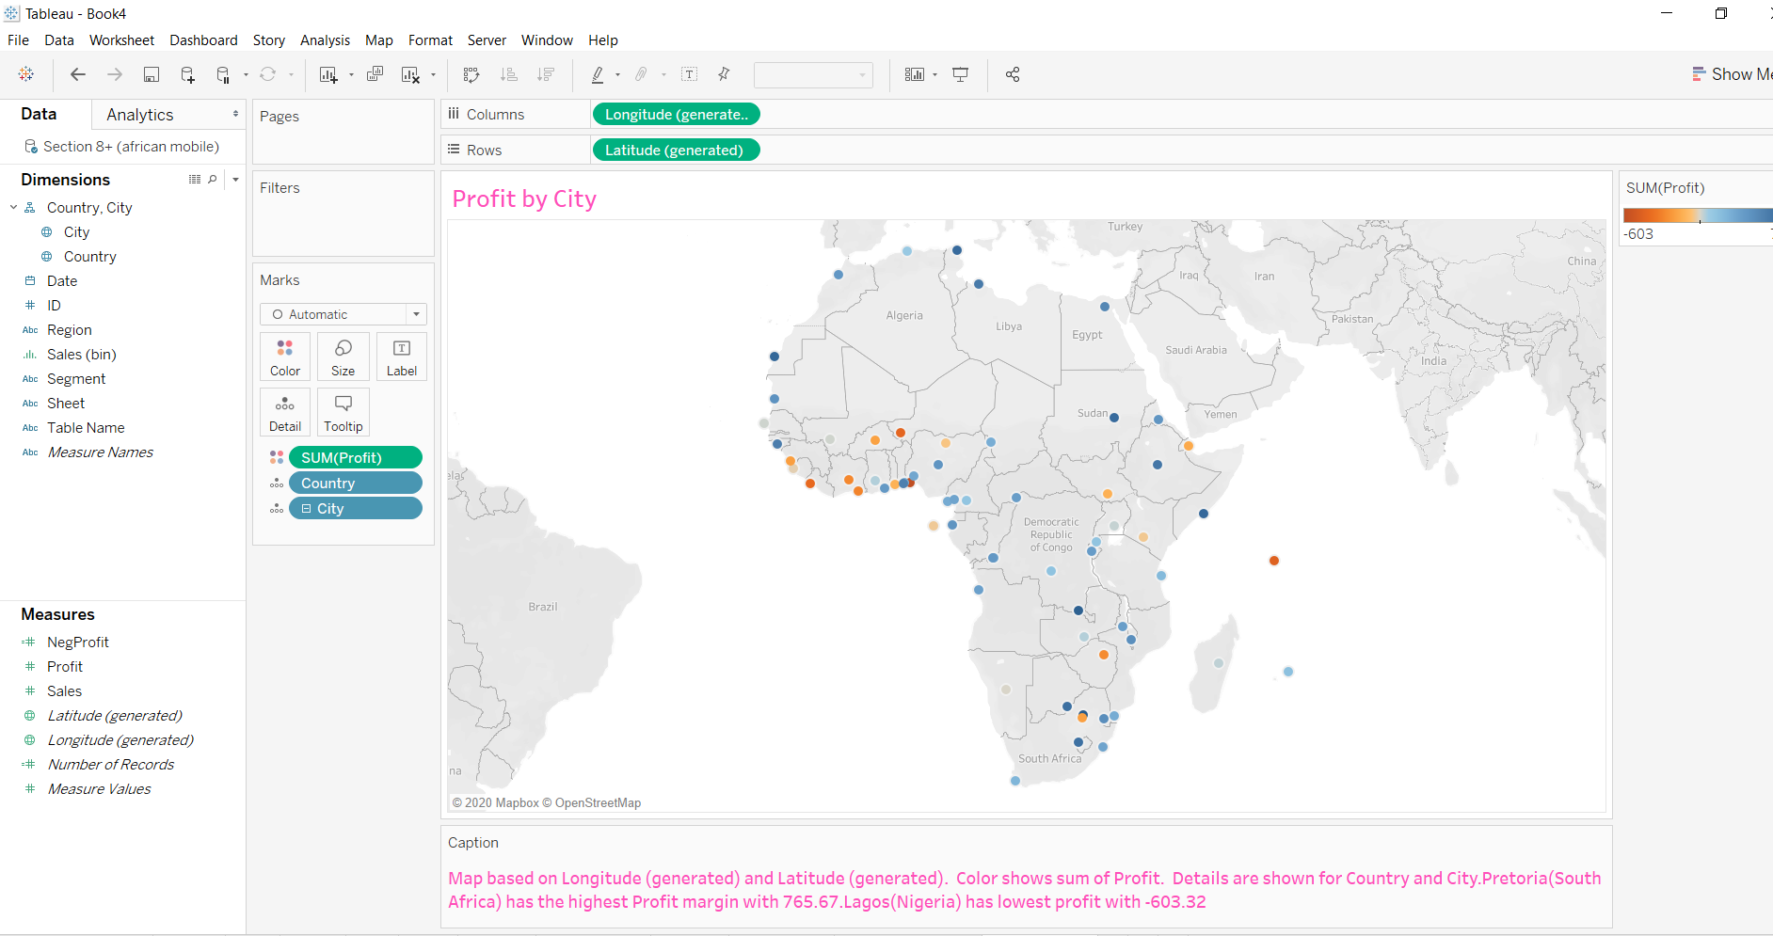

Slide 22
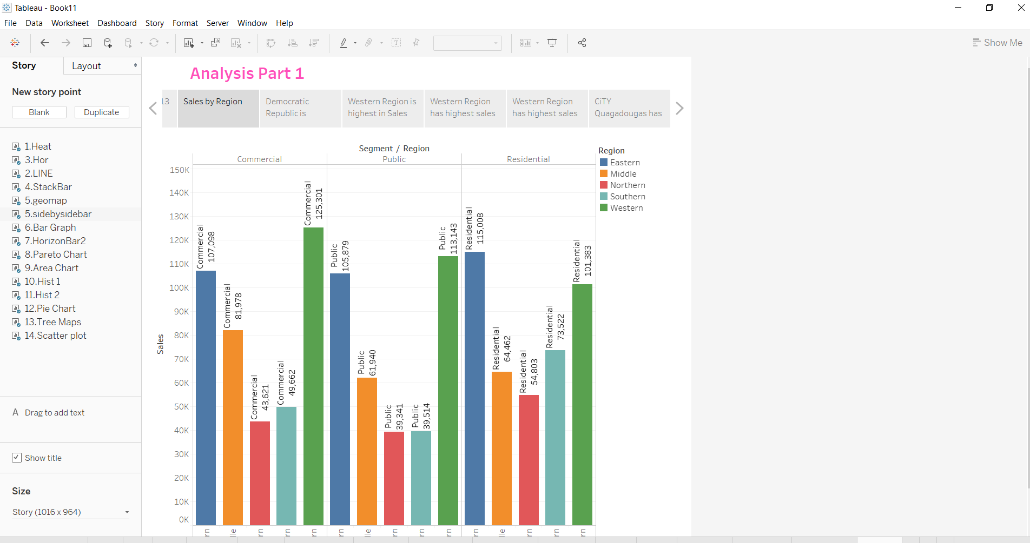

Slide 23
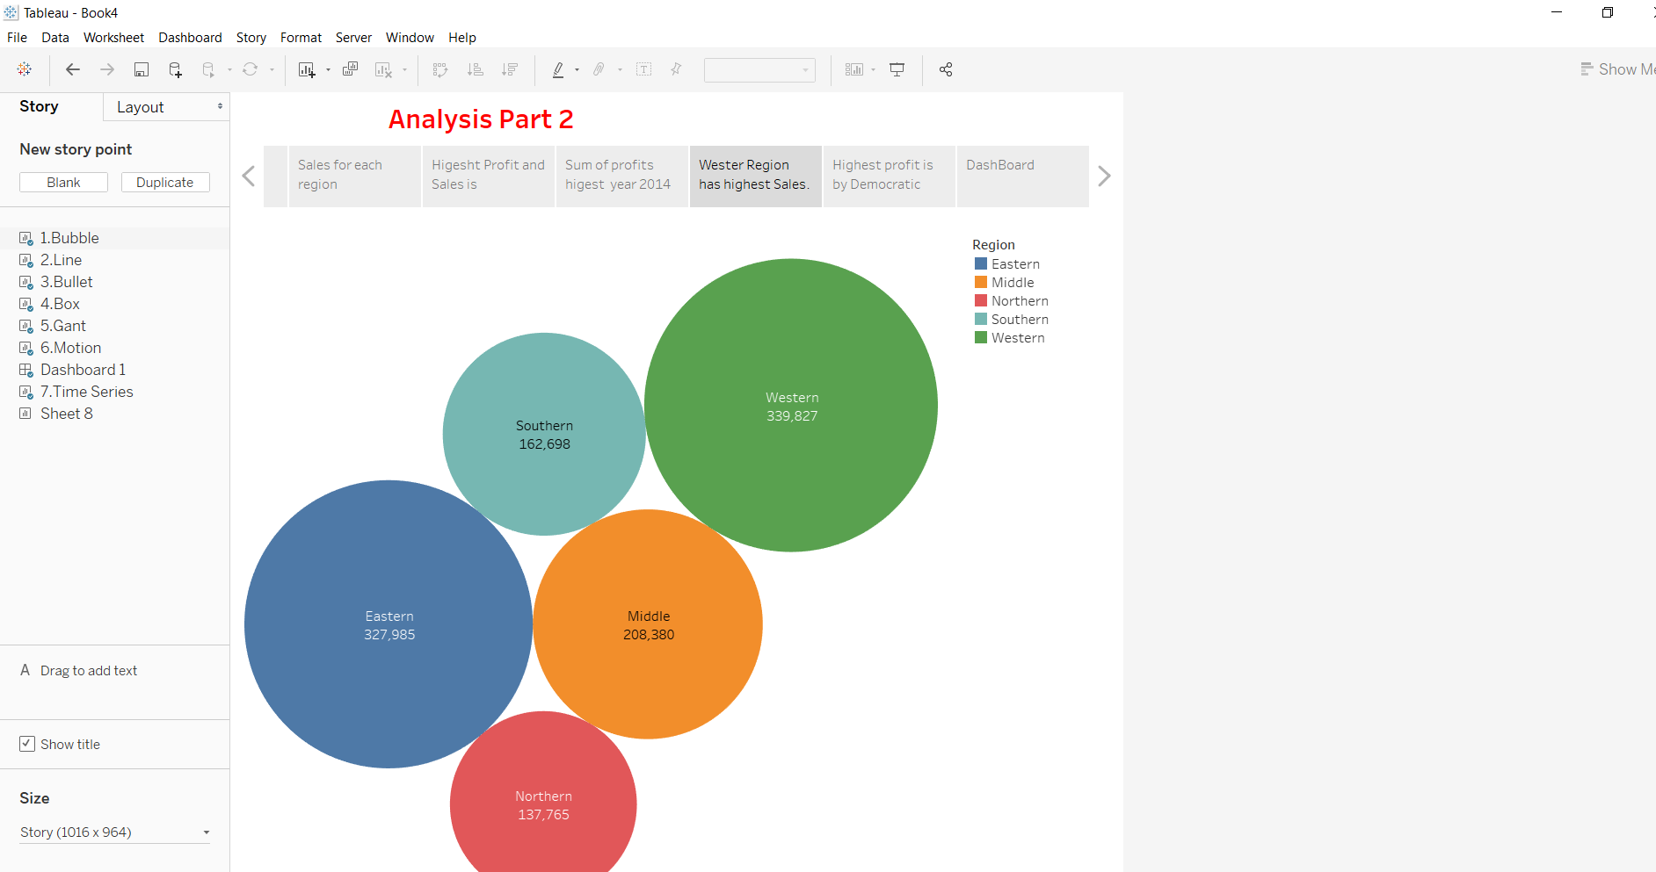

Slide 24
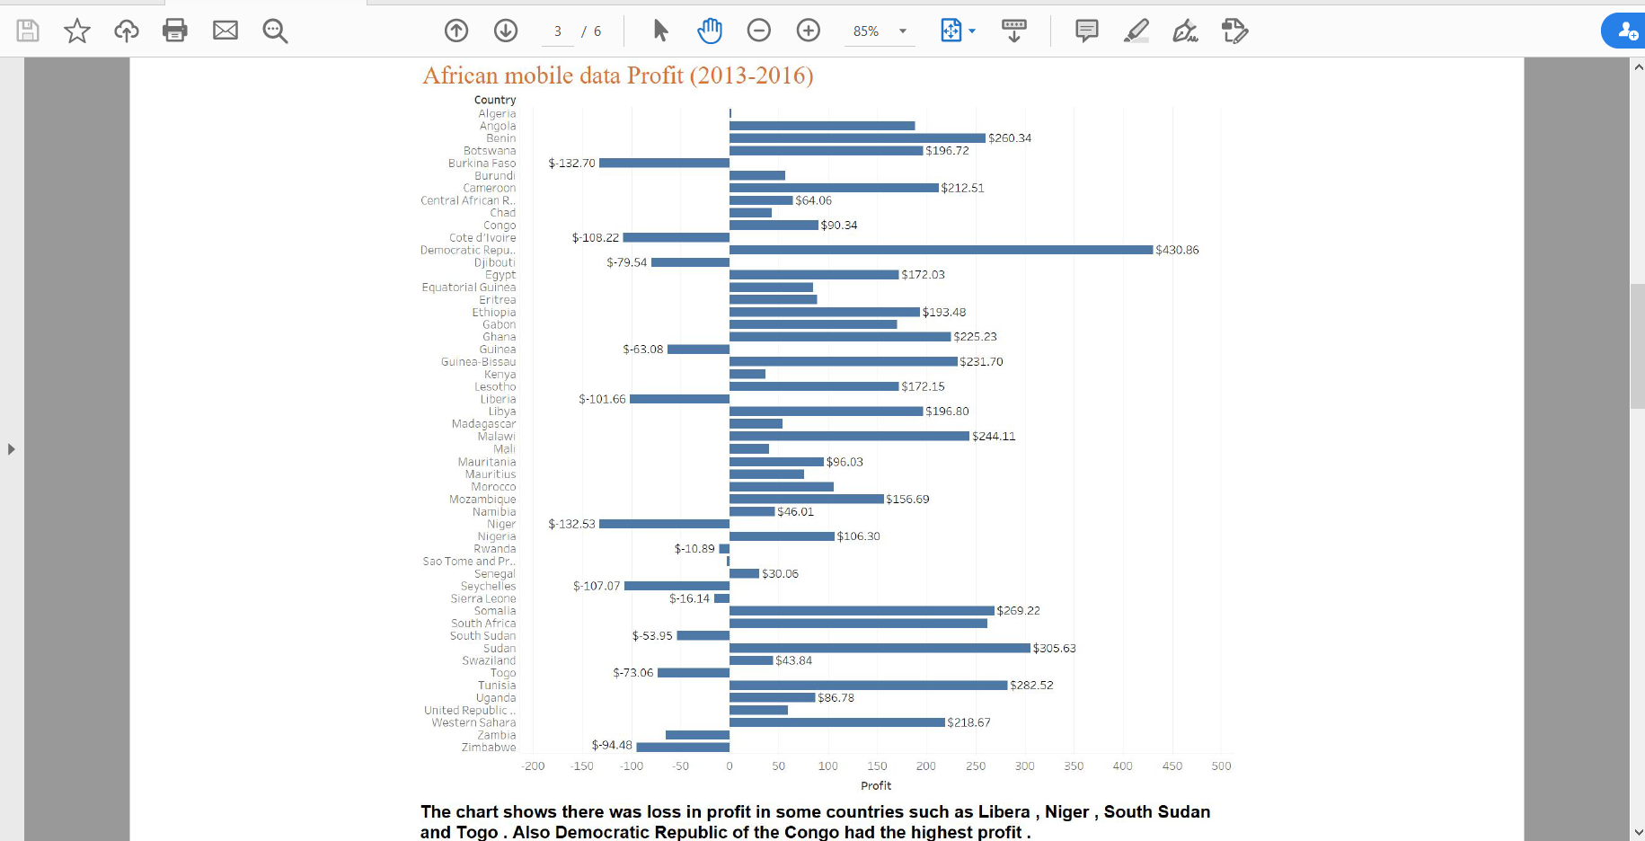

Slide 25
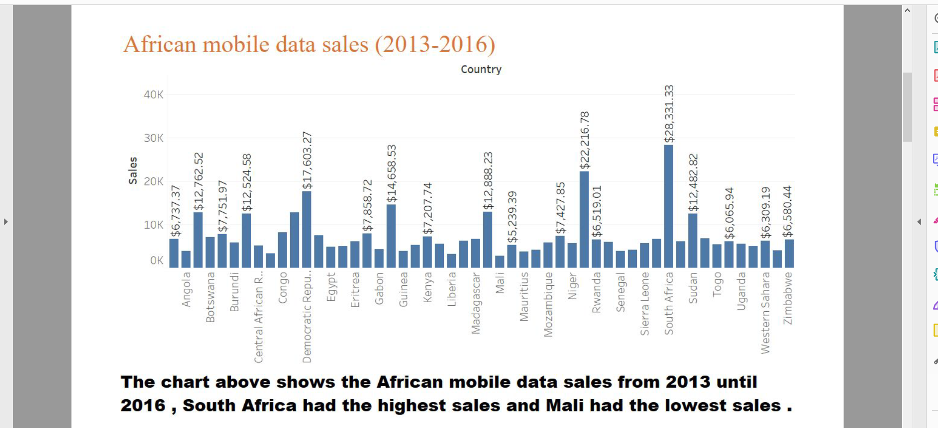

Slide 26
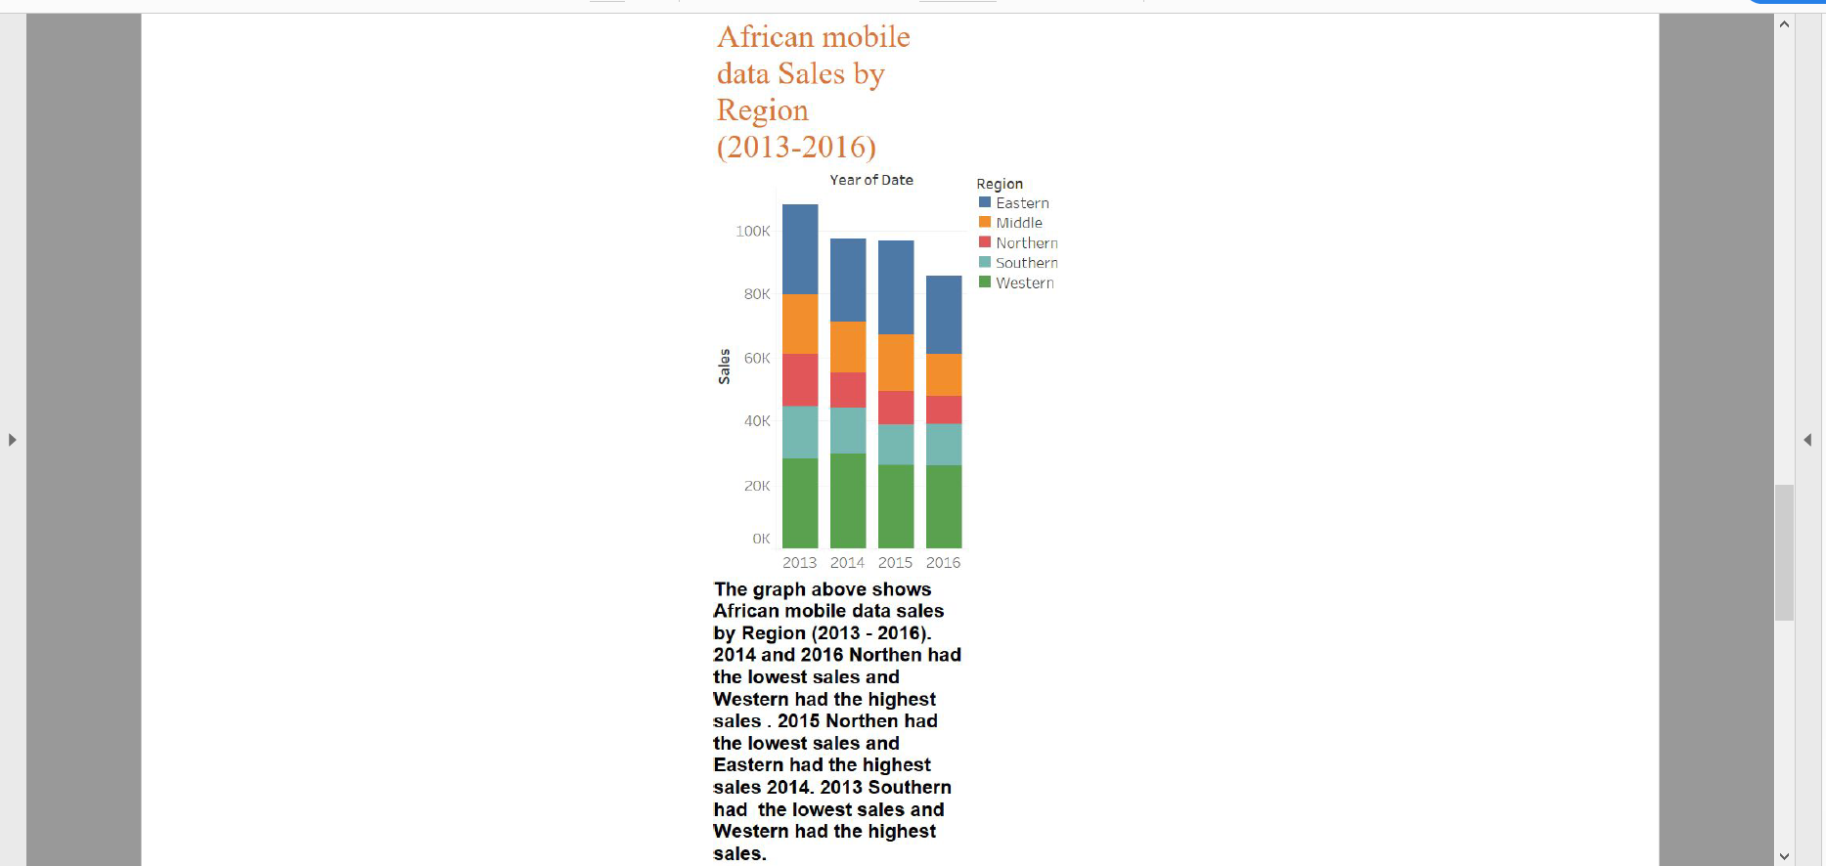

Slide 27
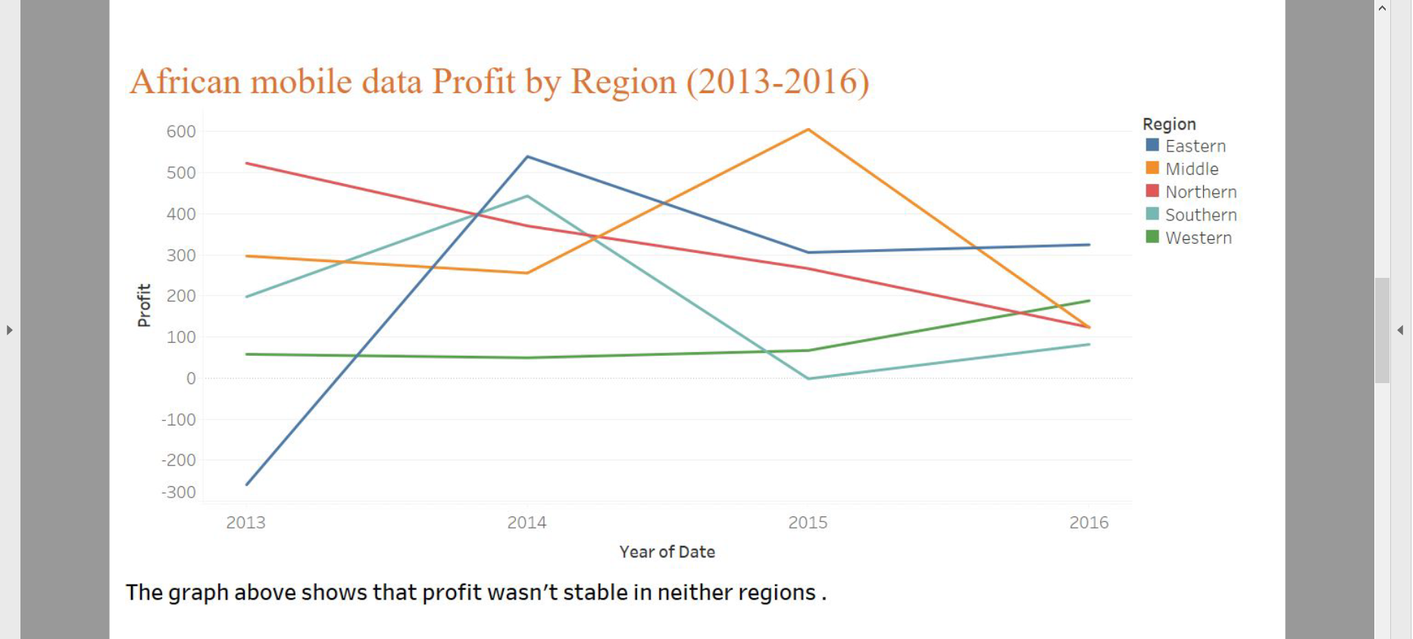

Slide 28
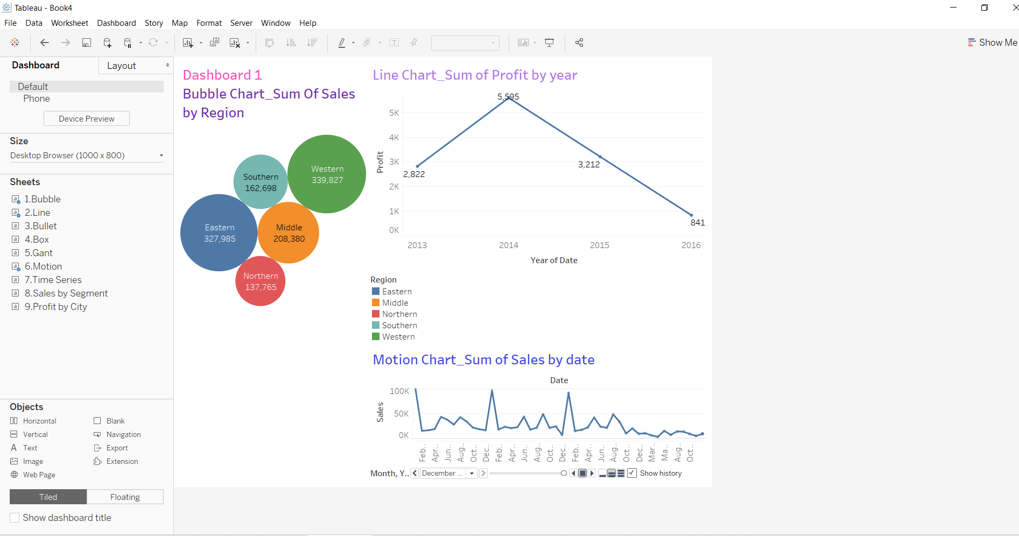

Slide 29
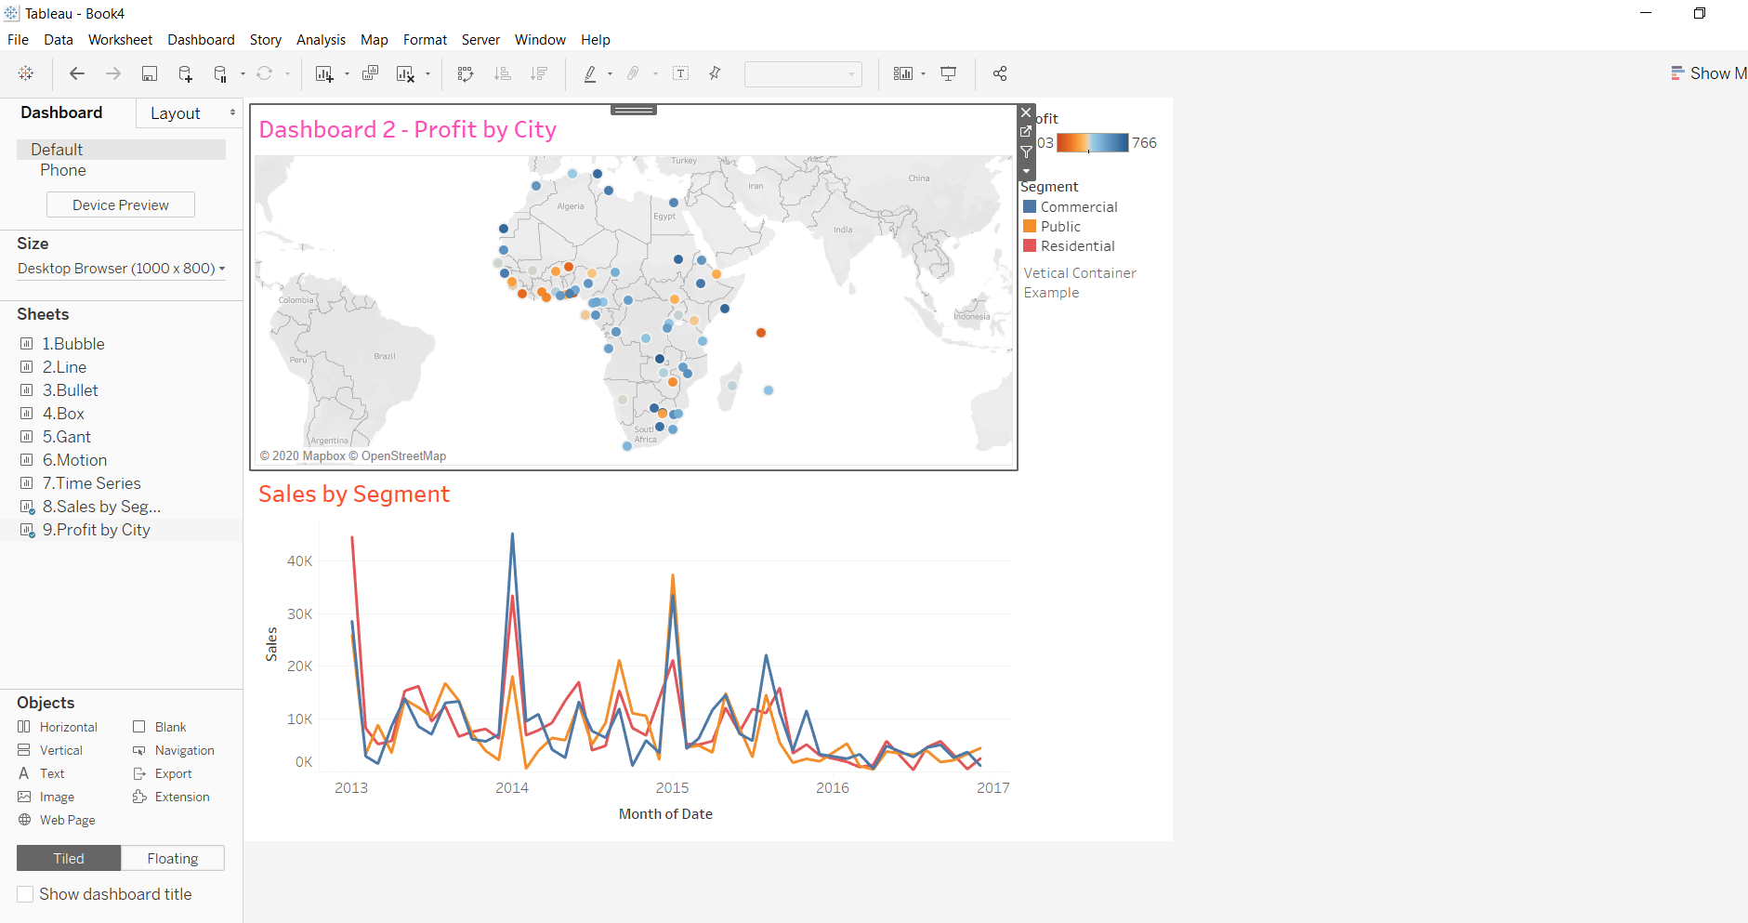

Slide 30
CONCLUSION
Western Region has the highest Mobile Sales compared to Eastern,Middle,Northern and Southern regions.Northern region has the lowest Mobile Sales.
Country Democratic Republic of Congo has the highest Mobile Sales and Seychelles is lowest in Mobile Sales.
Commercial and Public Mobile Sales are highest in western Region and low in Northern Region.Residential Mobile Sales are high in Eastern Region and low in Northern Region.
Mobile Sales are highest in the Year 2013 and lowest in the Year 2016

Slide 31
CONCLUSION
Sum of Profits are high in the Year 2014 and low in the Year 2016.
Sum of Sales are highest in the first quarter of Jan 2013 and lowest in the 3rd quarter of 2016.
Sum of Profits are high in City Pretoria and low in City Lagos
Sum of Profits are highest in the Country Democratic Republic and lowest in the Country Niger.
Commercial Mobile Sales reached its Peak in Jan 2015,Residential Mobile
Sales reached its Peak in Jan 2013 and Public Mobile Sales reached iyts
Peak in Jan 2015.
City Pretoria has highest Profit Margin and City Lagos has lowest Profit Margin.

Slide 32


THANK YOU

